Slide 1
Epoxy Resin
Synthesis, Curing Chemistry , and Curing Methods
Widad .Salih
College of Scince
University of Basrah

Slide 2
Epoxy resin was discovered in 1938 by Pierre Castan, achemist in Switzerland.Epoxy resin has been used in a wide range of fields, such as paints, electricity, civil engineering, and bonds.This is because epoxy resin has excellent bonding property, and also after curing ,it has excellent properties on mechanical strength, chemical resestance, electrical insulation.
In addition, epoxy resin is able to have various different properties as it is combined and cured together with various curing agents.
In general, uncured epoxy resins have poor mechanical, chemical and heat-resistance properties. However, good properties are obtained by reacting the linear epoxy resin with suitable curatives to form three-dimensional cross-linked thermoset structures known as curing. Curing of epoxy resins is an exothermic reaction, and in some cases produces sufficient heat to cause thermal degradation if not controlled.

Slide 3
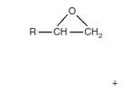
Widad .Salih
Epoxy Group
Epoxy Group, or Oxirane Group
Epoxy resin belong to the principle polymers under the term thermosetting polymers, thermosetting polymers form
1- infusible polymers
2-insoluble polymers

Slide 4
Widad .Salih
Synthesis of epoxy resin
1- Reaction of active hydrogen compounds with EPC
2- Epoxidition of double bonds
1- Reaction of active hydrogen compounds with EPC
Active hydrogen compounds means any compounds containing hydrogen attach atoms more electronegatives than hydrogen like hydroxyl compounds ( phenols), amines, mercaptane , carboxylic acid , alcohol

Slide 5
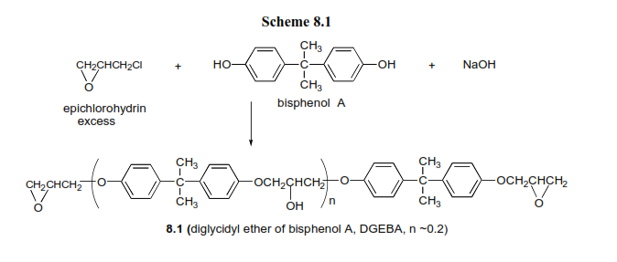
Widad .Salih
Commercial liquid epoxy resin are prepared using different molar ratios of epichlorohydrin to bisphenol-A- to afford different molecular weight products.High molecular weight solid epoxy resin with n values ranging from 2 to 30 are prepared by two process.
1- low molecular weight solid resins with n values to 3,7 are prepared directly from epichlorohydrin, bisphenol A and stoichiometric amount of NaOH .

Slide 6
Widad .Salih
2- Chain extension reaction of liquid resin with bisphenol A using sodium hydroxide
Multifunctional epoxy resin such as aromatic glycidyl ether resin and aromatic glycidyl amine resin are commercialy available.
Epoxy Novolac

Slide 7
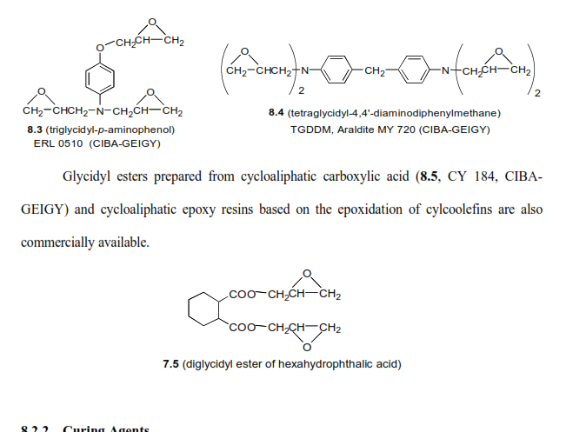
Widad .Salih

Slide 8
Widad .Salih
Curing Agents
Treatment of epoxy resin with curing agents or hardeners gives three-dimensional insoluble and infusible networks. Epoxy resin can be cured with a wide variety of curing agents. The choise of curing agents depends on
1- curing conditions.
2-chemical properties.
3-required physical and mechanical properties
4- time of complete curing..
5- Type of epoxy resin and hardener.
6- Pot life and Gel Time
Epoxy resin can be cured with : Catalytic , or Coreactive curing agents
Curing may be achieved by reacting an epoxy with itself or by forming a copolymer with polyfunctional curatives or hardeners. In principle, any molecule containing a reactive hydrogen may react with the epoxide groups of the epoxy resin. Common classes of hardeners for epoxy resins include:

Slide 9
Widad .Salih
-Co-reactive curing agents acts as commoner in the polymerization process such as
1- Amines :
1-1-Aliphatic amines
1-2- Aromatic amines
1-3-Modified amines
2- Polyamine Resin
3- Tertiary and Secendary amines
4- Imidazoles
5- Polymercaptan curing agents
5-1- Liquid polymercaptain
5-2- Polysulphide resin
6- Anhydrides
7- Latant-curing agents
7-1-Boron trifluride-amines complex
7-2- Dicyanamides
7-3-Organic acid hydrides
8-Photo-and Ultraviolet-curing agents
- Catalytic curing agents function as initiators for epoxy resin homopolymerization like lewis base and acids

Slide 10
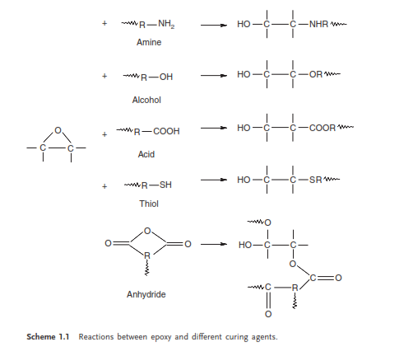
Widad .Salih
Hh
Epoxy Resin

Slide 11
Widad .Salih
Reaction of primary amine and Epoxy resin

Slide 12
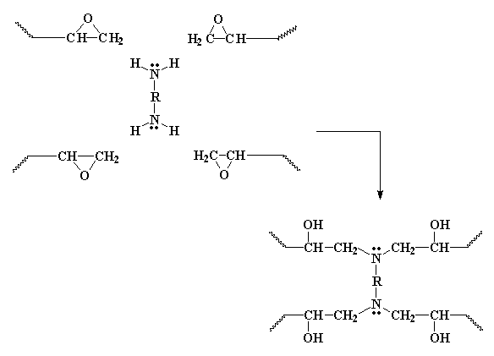
Widad .Salih

Slide 13
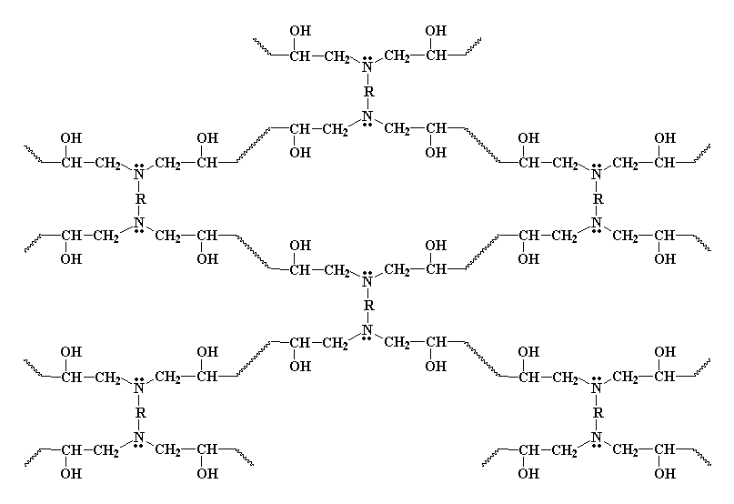
Widad .Salih

Slide 14
Widad .Salih
Modified amine curing agents ( amine –Adduct )
The modification of amine curing agents improve the workability as follows :
1-Extende the pot life
2- Increase or decrease the curing speed
3-Improve compatibility with resin
4-Reduces toxicity and irritation to the skin
5-Decrease weighing error because loading amount is increase.
How to Prepare Amine Adducts
When epoxy resin is allowed to react with an excessive amount of polyamine such as ( DETA)consume all of the epoxy groups , an amine adduct having active hydrogen of the residual amino groups is formed. As the adduct has molecular weight,
it is less volatile, release less amino odor, is less toxic, and less exothermic.

Slide 15
Widad .Salih
Ketimine as Curing Agents
Ketimine , which is used as curing agents for high solid paints epoxy , it is prepared from the reaction of amines such as DETA, TETA and ketones like ethyl methyl ketone
Ketimine cure very slowly when mixed with epoxy resin absorb moisture in the air and regeneration amine to cure at room tempreture, application of this kind is limited to thin film coated

Slide 16
Widad .Salih
Polyamide Curing Agents
Polyamide resin, which has been widely used as curing agent for epoxy resin, is formed by the condensation reaction between dimer acid and polyamine, containing primary and secondary amine.it cure epoxy resin into highly plasticizer rigid thermosetting polymers and the cured resin have good mechanical properties.
Polymercaptan Curing Agents
Polymercaptan, cures at 0 C to -20 C and requires tert. Amine as an accelerator

Slide 17
Widad .Salih

Slide 18
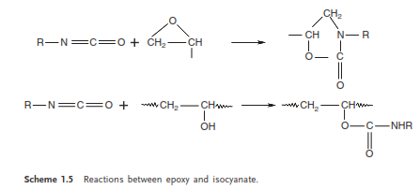
Widad .Salih
Isocyanate Curing Agents
Epoxy groups react with isocyanate or with hydroxyl group to produce oxazolidone structure or a urethane linkage

Slide 19
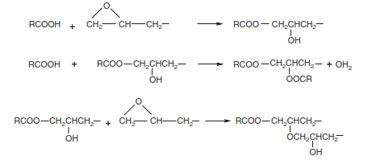
Widad .Salih
Carboxylic Curing Agents

Slide 20
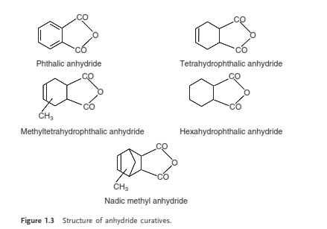
Widad .Salih
Anhydride Curing Agents
Two mechanism in this curing
1-with out catalyst.

Slide 21
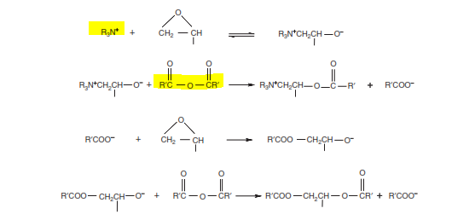
Widad .Salih
2-with catalyst
Zzwitter ion

Slide 22
Catalytic Curing Agents
Catalytic curing agent can be used for homopolymerization , the cured resin have high tempreture resistance, Tert.amine used in this process
Mechanism
Ffirst Step

Slide 23
Synthesis of Epoxy Resin by Epoxidation of Double Bonds
The second most important method for manufacturing epoxy resin is by the epoxidation of olefins. There are three important routes for producing epoxides from olifines
1- Catalytic epoxidation in the vapour phase in the presence of silver as catalyst
2- Epoxidation by organic peroxides and their ester.
3- Epoxidation by inorganic peroxide and inorganic peroxy acids.

Slide 24
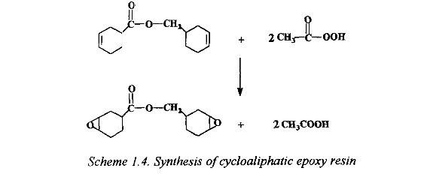

Slide 25
Curing Methods
Epoxy resin are cured by various methods
1- Chemical Curing ( under ambient temp. or high temp. )
2- Microwave Curing
3-Radiation Curing ( electron –beam , Ultraviolet radiation ).
Note: The mechanism of curing methods differs in these methods. Thermal curing takes place through a step polymerization mechanism, while the radiation curing leads to chain polymerization involving initiation, propagation and termination. The properties of the cured polymer differ in both case.
Toughening of Epoxy Resin
The term toughness is ameasure of material s resistance to failure.
Epoxy resin are characterized by their outstanding properties such as : high thermal and corrosion resistance, good thermomechanical properties , and adhesion to various sustances. Inspite of these properties, the major disadvantages are their low toughness, poor crack resistance and brital nature at room tempreture
So epoxy resin are to be toughened for many end-use application.

Slide 26
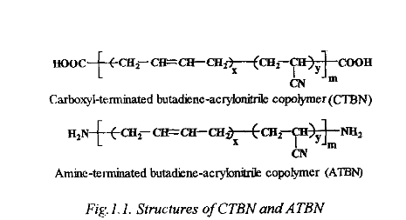
Epoxy modifier with liguid rubber

Slide 27
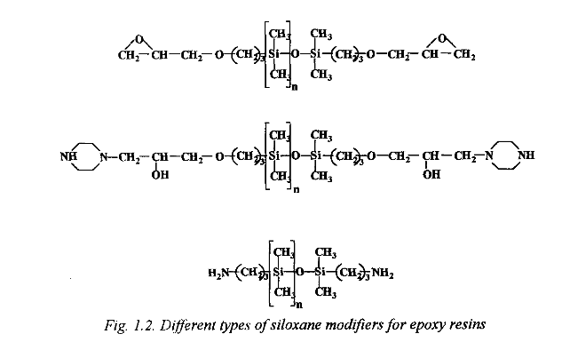
Epoxy resin modified with siloxane

Slide 28
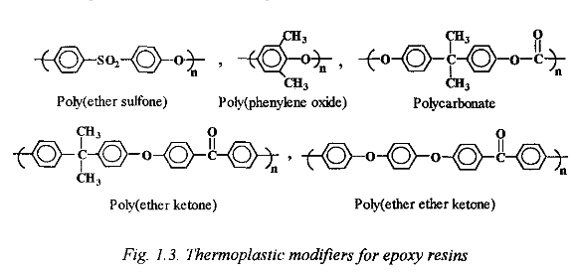
Epoxy resin modified with thermoplastic

